Slide 1
The Effects of Object Shape, Fidelity, Color, and Luminance on Depth Perception in Handheld Mobile Augmented Reality Tiffany D. Do , Joseph J. LaViola Jr. , Ryan P. McMahan Sepehr (Sep) Sabeti – ITCS 4123/5123 – Visualization and Visual Communications

Slide 2
Overview
Problem
Contribution
Methodology
Experimental Design
Research Questions
Data Collection and Participants
Results
Future Work

Slide 3
Problem
Importance of depth perception in visual applications, especially augmented reality is undeniable.
It is important to investigate the effect of color and luminance in depth perception.
Warmer colors are supposed to be nearer than cooler colors.
Luminance is a better cue than hue.
Previous studies have only investigated these effects on real objects, and mostly 2D objects.

Slide 4
Contribution
Investigate the effects of object shape, fidelity, color, and luminance on depth perception of 3D objects in handheld mobile AR.

Slide 5
Methodology
Conducting a preliminary paired comparison experiment to group colors into distinct groups of similar perception.
Administered the procedure for objects of varying shape and fidelity

Slide 6
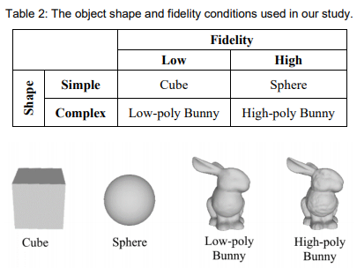
Experimental Design
a 2 x 2 x 6 x 2 within-subject experiment to evaluate the effects of object shape (2 shapes), fidelity (2 levels), color (6 hues), and luminance (2 levels) on depth perception for handheld mobile AR applications.

Slide 7
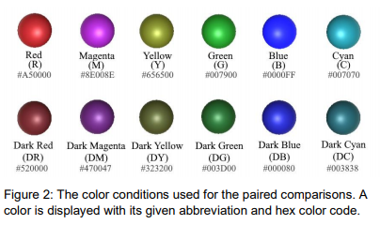
Experimental Design
Six color hues representing the spectrum of colors, three warm colors (red, magenta, and yellow) and three cool colors (green, blue, and cyan), both a bright and dark version of each color, giving us a total of 12 color conditions.

Slide 8
Research Questions
RQ1: How does the shape of a 3D model interact with color and luminance as depth cues?
RQ2: How does the fidelity of a 3D model interact with luminance and color as depth cues?
RQ3: How does the color of a 3D model affect its perceived depth?
RQ4: How does the luminance of a 3D model affect its perceived depth?

Slide 9
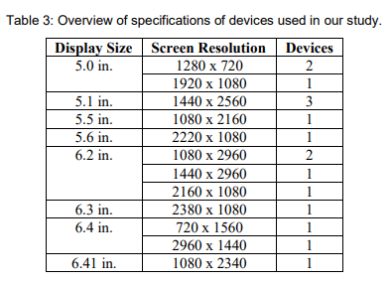
Data Collection and Participants
8 females, 8 males
mean age was 24.76 years

Slide 10
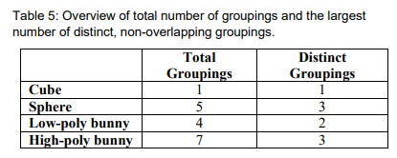
Results
H1 partially supported.
H2 fully supported.
H3 (Color) was not supported.
H4 (Luminance) was partially supported .

Slide 11
Results – H1
We cannot conclude that the depth perception of the low-fidelity, simple shape (the cube) is affected by color and luminance. However, the high-fidelity, simple shape (the sphere) was the only model that demonstrated classical effects of color on depth perception.

Slide 12
Results – H2
The low-fidelity cube had only 1 total grouping, while the high-fidelity sphere had 5 total groupings and 3 distinct non-overlapping groupings. The low-fidelity bunny had 4 total groupings and 2 distinct groupings, while the high-fidelity bunny had 7 total groupings and 3 distinct groupings.

Slide 13
Results- H3
Warm colors of the same luminance were not perceived as closer than cool colors for all objects, except for red in the sphere condition.

Slide 14
Results – H4
Except for the cube, most of the bright colors were perceived as significantly closer than their darker counterparts.

Slide 15
Future Work
The effects of object shape, fidelity, color, and luminance in a more ecologically valid application context

